Slide 2
What is Teaching Fellows?
Mission of the Teaching Fellows Program: To recruit talented high school seniors into the teaching profession and help them develop leadership qualities.
Each year, the program provides Fellowships for up to 200 high school seniors who have exhibited high academic achievement, a history of service to their school and community, and a desire to teach in South Carolina.

Slide 3
LET’S MONEY!
Up to $6,000 annually for 4 years!
So WHAT’S THE ?
You have to teach in a South Carolina every year you receive funding!

Slide 4
What gain from Teaching Fellows ?
Advanced Educational Experiences
A family throughout your entire college career!
Opportunities:
Freshman Retreat!
Sophomore Conference!
Conference of Choice!
Senior Hill Day/Professional Development Money

Slide 5
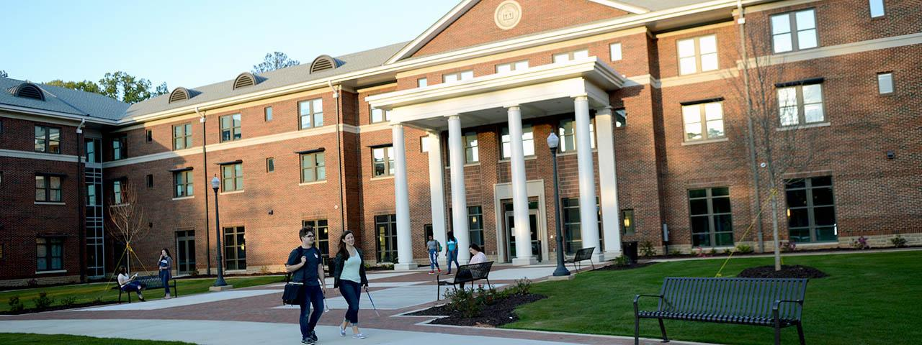
WHAT DOES LANDER HAVE TO OFFER ?
Dorm Variety
Sports Team/Intramural Teams
Group Exercise Teams
Spin, Zumba, Crossfit, Yoga
Outdoor Experiences
Skydiving, Hiking, Riverbank Zoo Trips, etc.
5K Runs
Color Run, Moonshine Run, Glow Run, Autism 5K, etc.
Homecoming
Fraternities and Sororities
Mr. and Miss Lander Pageant
Family Day
Holiday Tree Lighting
Fun University Events
comedians, musicians, singers, speakers, movies, etc.

Slide 6
Campus________________________
Academic Success Center
Writing Center
Jackson Library
Information Technology Services (ITS)
Lander University Police Department (LUPD)
Wellness Center

Slide 7
COLLEGE
TRIPS!
New York City!
Exclusive Classes and Housing
Study Abroad/Internships
Available Scholarships
Register with the Seniors!
Seperate Application!

Slide 8
Meet some of our Teaching Fellow cohorts here at Lander!

Slide 9
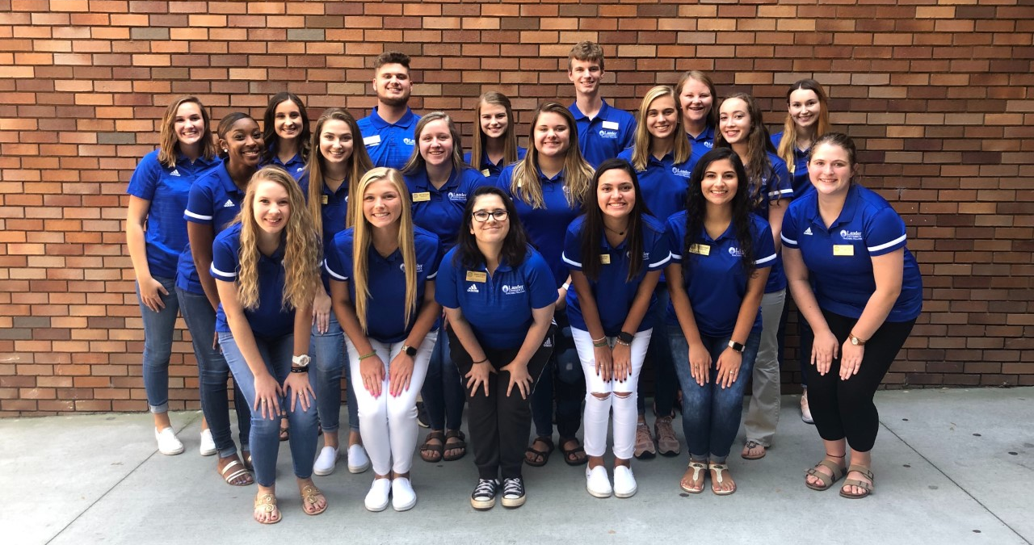
Sophomore Cohort

Slide 10
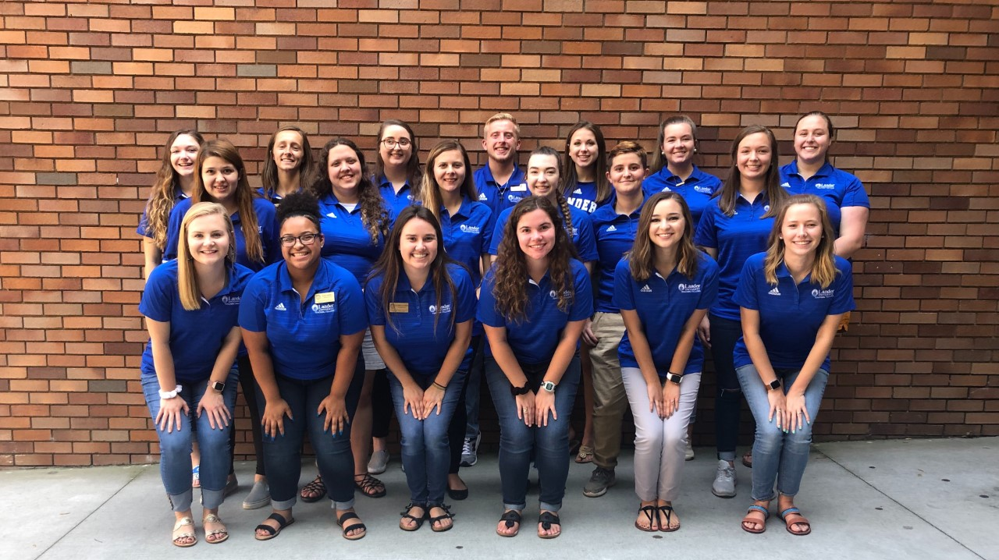
Junior Cohort

Slide 11
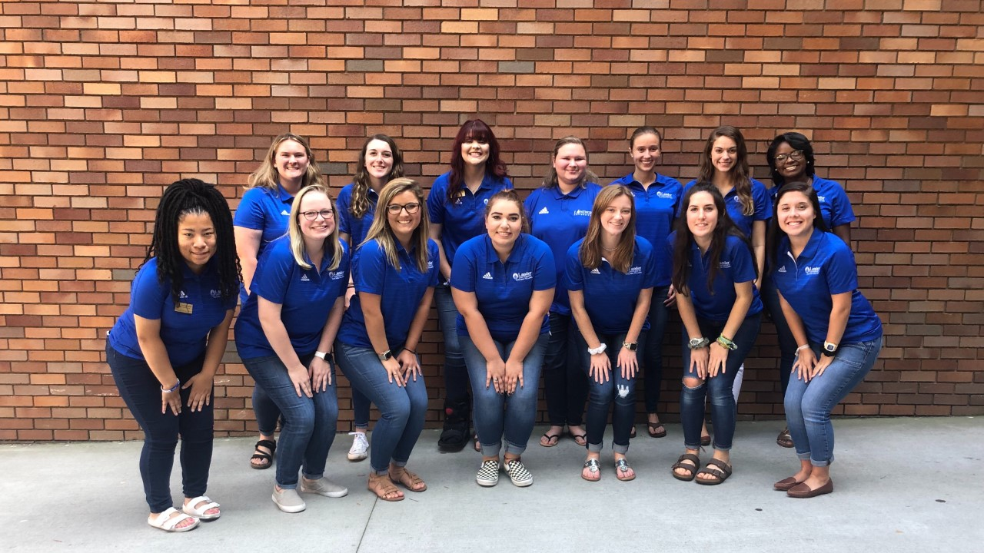
Senior Cohort

Slide 12
Kind of Interested in Teaching Fellows?
Go to South Carolina’s Teaching Fellows website (www.cerra.org) to find out more about other the SC Teaching Fellow’s program, as well as other Teaching Fellow institutions around the State.
Check out Lander’s Teaching Fellow website (www.landerteachingfellows.weebly.com) to find out more about the Teaching Fellows program here at Lander.

Slide 13
Really Interested in being a Teaching Fellow? Here are your next steps:
Find the Teaching Fellow application on the SC Teaching Fellow website and apply by December 1^{st.}
Wait to receive your letter about your qualification for the second round of the application. Letters will be received no later than January 8^{th.}
Prepare for your interview by coming to Lander’s Mock Interview Day!
Attend your interview on February 20th
^{Wait to here back from CERRA}
^{Become a Teaching Fellow!!}

Slide 14
We are so thankful to be given the chance to talk to you all about Lander Teaching Fellows!
Questions?

